Slide 1
Technin 510 Week 6
Front End Basics
11/3/21

Slide 2
Today
Front End Basics
The DOM
Events (Python, JS, HTML)
SVG and Canvas
Lunch
Technin510 L6 Make a Robot Face

Slide 3
Document Object Model (DOM)
The DOM
JS
HTML
CSS
XML
A platform and language-neutral interface that allows programs and scripts to dynamically access and update the content, structure, and style of a document (W3C)

Slide 4
HTML DOM: With the object model, JS gets all the reference point it needs to create dynamic HTML
Document
Root element: <html>
Element: <head>
Element: <title>
Text: “My Title”
Element: <body>
Element: <a>
Attribute: “href”
Text: “My link”
Element: <h1>
Text: “My Header”
JS can…
Change all the…
HTML elements
HTML attributes
CSS styles
Remove existing HTML elements/attributes
Add new HTML elements/attributes
React to all existing HTML events
Create new HTML events
… in the page

Slide 5
Functions to access DOM elements
Method | Description
document.getElementById(<id>) | Find an element by element id
document.getElementsByTagName(<name>) | Find elements by tag name
document.getElementsByClassName(<name>) | Find elements by class name

Slide 6
Changing DOM elements
Property | Description
element.innerHTML = <new HTML content> | Change the inner HTML of an
element.attribute = <new value> | Change the attribute value of an HTML element
element.setAttribute(<attribute>, <value>) | Change the attribute value of an HTML element
Element.style.property = <new style> | Change the style of an HTML element

Slide 7
Changing DOM elements
<html> <body> <p id="demo"></p> <script> document.getElementById("demo").innerHTML = "Hello World!"; </script> </body> </html>
Property
Method

Slide 8
Changing DOM elements: Example, Lab 5
var urls = thumbnails.innerHTML.split("\n")
urls.sort(() => Math.random() - 0.5);
var str = ""
for (let i=0; i<urls.length;i++){
str += urls[i] + "\n"
}
// console.log(str)
document.getElementById("thumbnails").innerHTML = str
Method
Property

Slide 9
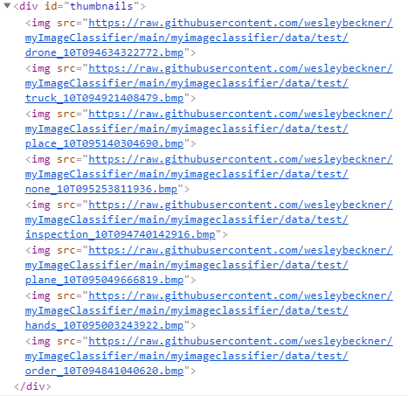
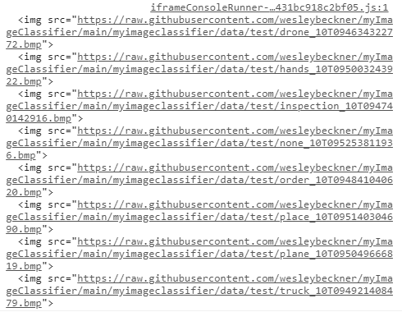
Changing DOM elements: Example, Lab 5
var urls = thumbnails.innerHTML.split("\n")
urls.sort(() => Math.random() - 0.5);
var str = ""
for (let i=0; i<urls.length;i++){
str += urls[i] + "\n"
}
// console.log(str)
document.getElementById("thumbnails").innerHTML = str
thumbnails
innerHTML

Slide 10
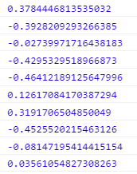
Changing DOM elements: Example, Lab 5
If the result is negative a is sorted before b.
If the result is positive b is sorted before a
var urls = thumbnails.innerHTML.split("\n")
urls.sort(() => Math.random() - 0.5);
var str = ""
for (let i=0; i<urls.length;i++){
str += urls[i] + "\n"
}
// console.log(str)
document.getElementById("thumbnails").innerHTML = str
urls.sort(function(a, b){return Math.random() - 0.5});

Slide 11
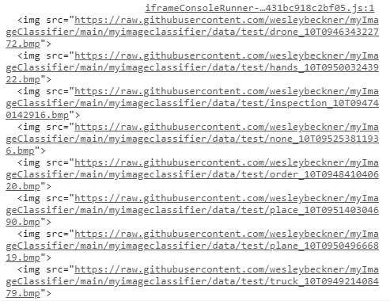
Changing DOM elements: Example, Lab 5
Create a new string of the scrambled urls
var urls = thumbnails.innerHTML.split("\n")
urls.sort(() => Math.random() - 0.5);
var str = ""
for (let i=0; i<urls.length;i++){
str += urls[i] + "\n"
}
// console.log(str)
document.getElementById("thumbnails").innerHTML = str

Slide 12
Changing DOM elements: Example, Lab 5
var urls = thumbnails.innerHTML.split("\n")
urls.sort(() => Math.random() - 0.5);
var str = ""
for (let i=0; i<urls.length;i++){
str += urls[i] + "\n"
}
// console.log(str)
document.getElementById("thumbnails").innerHTML = str
Set the DOM element attribute to the new value

Slide 13
Adding/deleting DOM elements
Method | Description
document.createElement(<element>) | Create an HTML element
document.removeChild(<element>) | Remove an HTML element
document.appendChild(<element>) | Add an HTML element
document.replaceChild(<element>) | Replace an HTML element
document.write(<text>) | Write into the HTML output stream

Slide 14
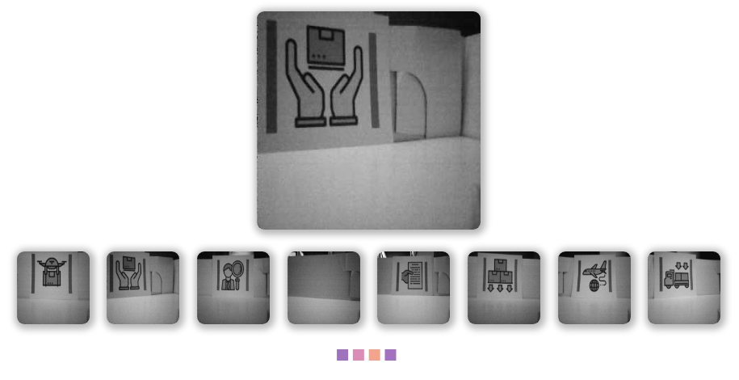
Events
Python/HTTP
HTML
JS

Slide 15
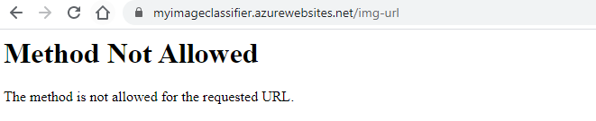
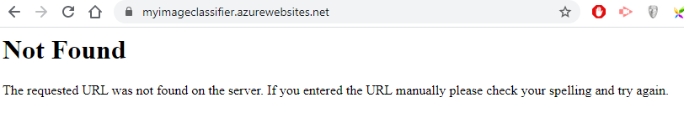
Events in Python/HTTP
What is a callback
Post and get requests
Why do we see this message?
What about this one?

Slide 16
What is a callback?
A function that is to be executed after another function has finished executing
A way to make sure certain code doesn’t execute until other code has already finished execution

Slide 17
So how does this work in our Flask app?
route(rule, **options): A decorator that is used to register a view function for a given URL rule
When the user visits “/” run index()
Demo: base url “/” and get request
@app.route('/’)
def index():
pass

Slide 18
Events and Callbacks: HTML
Callback function
<button type="button" onclick="hello()">
Event name

Slide 19
Events and Callbacks: JS
Bind to the DOM
Event name
Callback function
document.getElementById("myBtn").addEventListener("click", function() {
document.getElementById("demo").innerHTML = "Hello World";
});
Or
document.getElementById("myBtn").onclick = myFunction;
Other mouse click event names…
onlick
onmousedown
onmouseup
ondblclick
ontextmenu

Slide 20
Events and Callbacks: DOM Events
onlick, onmousedown, onmouseup, ondblclick, ontextmenu
onload
When a user clicks the mouse
When a webpage has loaded
When an image has loaded
When the mouse moves over an element
When an input field is changed
When an HTML form is submitted
When a user strokes a key
onmousemove, onmouseover, onmouseout
onchange
onsubmit
onkeydown, onkeypress, onkeyup

Slide 21
Events and Callbacks: JS (lab 5)
var imgs = thumbnails.getElementsByTagName("img")
for(let i=0;i<imgs.length;i++){
let img=imgs[i]
img.addEventListener("click",function(){
main.src=this.src
…
Callback function
Event name

Slide 22
Browser Object Model
<input type="button" value="Back" onclick="window.history.back()">
Event name
Callback function
Accessing browser
This is the main JS object root, since it is root, you do not have to type ‘window’ to access any of its properties, the runtime will figure it out. Ex: window.document

Slide 23
Timing Events
one time
window.setTimeout(function, milliseconds)
window.setInterval(function, milliseconds)
repeated

Slide 24
SVG vs Canvas
SVG
Canvas
does for graphics what html does for text
Older
Open xml based language
Can style through svg elements or css
Animate without JS (support for event handlers)
Need to provide context to the DOM (‘2d’)
Once context is identified, there are a full host of APIs to use
Create using a set of definitions, like converting adobe actions to command line arguments
More efficient for creating web animations, often used for games

